Slide 1
Graphics Lab: Basic C++
Final project:
Procedural Building Generator

Slide 2
Team 2:
Naurin Jamil
Ruotong Li
Nicola Krombach
Jonas Abert

Slide 3
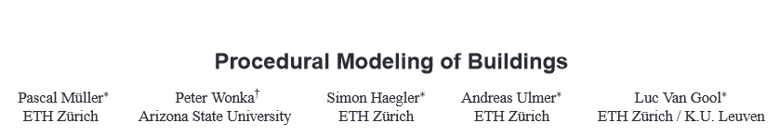
Task:
C++ implementation of the paper

Slide 4
Procedural modeling
“[…] produces extensive [3D] models for computer games and movies, at low cost. Context sensitive shape rules allow the user to specify interactions between the entities of the hierarchical shape descriptions.”
Müller et al. 2006

Slide 5
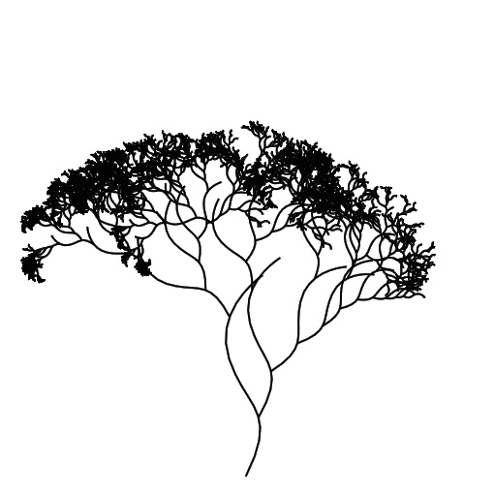
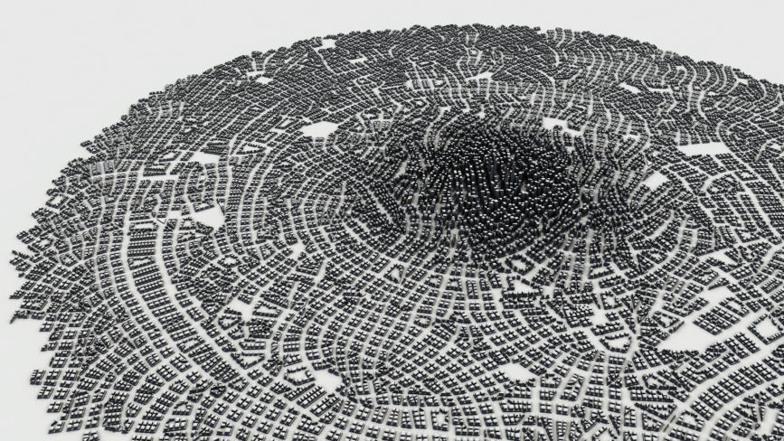
Application:
[1]
[2]
[1] http://lesterbanks.com/
[2] http://adobe.com

Slide 6
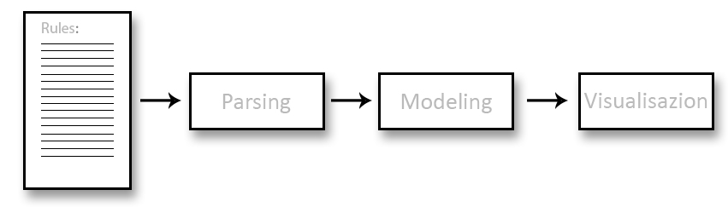
Basic Workflow:
Convert Grammar into Rules
Text File
(Grammar)
Apply Rules
Show result

Slide 7
Integration:
Jonas Abert

Slide 8
Tasks
Development
Design of the general program logic
Implementation of a framework that supports our needs
Management
Project coordination
Keeping an overview over the project at any given time
Support
Helping the others at developing and implementing their parts

Slide 9
Goals
Flexibilty
wide varriaty of procedural models
Definition through Grammar file only
Simplicity

Slide 10
Parsing:
Naurin Jamil

Slide 11
Tasks
Development
Affix the format for the grammar file to model different structures
Implement Split string to parse the rules
Design initial version of the Final Grammar
Affix the Grammar Data Structure to be implemented for modelling steps
Testing
Use a Test grammar to test the code for correct parsing

Slide 12
Why do we need to parse?
Parsing is the process of analysing a string of symbols in the language, according to the rules of a formal grammar.
It helps to perform formal analysis of a line or sentence(in our case, a line of rule) into its constituents, resulting in a parse tree, showing a syntactic relation to each other, which may contain semantic and other information.
Our Parser is a software component that takes input data as a Rules.txt file and builds a dataStructure from it, giving a clear representation of the input data and checking correct syntax in the process.

Slide 13
How do we parse?
Parsing is implemented in the following steps :
A grammar file format is specified, as in the referance paper, with a few alterations to simplify the lexical analysis. It is written as a Rules.txt file, that serves as the input for parsing
The individual rules are read from Rules.txt file, rule constituents are identified and filled in the object/dataStructure as its different parameters, that are used in the subsequent implementation steps.

Slide 14
Implementation
sidewing->S(1r,1r,Scope.sz*rand[0.4-1.0]) {facades}:0.5->S(1r,Scope.sy*rand[0.2-0.9]) {facades}: 0.3-> () {epsilon}: 0.2
sidewing – SymbolID
S – Function
(1r,1r,Scope.sz*rand[0.4-1.0])- parameters
facades – NewIDs/ SymbolIDs
0.5 - probability
.. And so on are the segregated consituents of the rule obtained by parsing, that are filled as the object parameters

Slide 15
Parsing code Logic
What is the code logic behind Parsing?
Two text files are passed as input, one for reading the model configuration as config.txt and other for the defined rules as Rules.txt
Read the configuration in the defined function and save the parameters in a map<ID, value>config
Split the read rule lines by calling the split function and populate the vectors of type string with the rule constituents like, function, SymbolIDs, parameters, probability
GNode is our defined dataStructure that stores the above constituents
Finally, we define vector<pair < SymbolID, vector<Gnode>> ruleSet.

Slide 16
Visual Representation
Gnode
< , >
“functionName”
“SymbolName”
GNode
<parameter values>
“childSymbolNames”
probability

Slide 17
Results
Output of parsing
Parsing results in populating the vector<pair< SymbolID, vector<Gnode>> ruleSet.
This map is the dataStructure used by the subsequent Modelling step.
The keyword SymbolID is used to query the map, so it is essenially unique
All the functions applied on this symbol are stored in the vector of Gnode
So, one Gnode only stores the information of one function, also its probability

Slide 18
Modeling:
Ruotong Li

Slide 19
Tasks
Read rule from rule set I got from Parsing
apply GNode on Symbols
store new created Symbols into the deviation tree

Slide 20
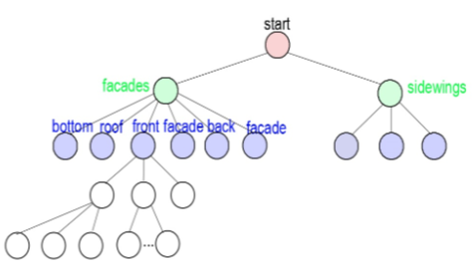
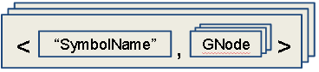
How to do it?
Task:
using the ruleset to create a deviation tree
Idea:
take the pair one by one to GNode on the tree_elements
Notes:
as we know from parsing part, each pair is a rule

Slide 21
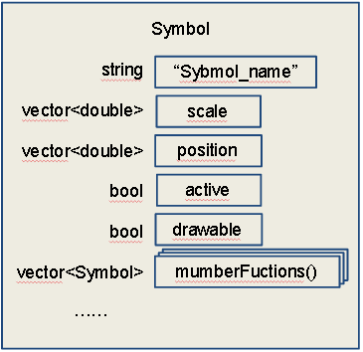
What is the tree_element?
Symbol
it is the basic element of the deviation tree
it represents the simple 1D, 2D or 3D elements
lines, plane and boxes
it contains element atributes
position, scale, name
it can apply rules to create new Symbols
Notes:
with position and scale
we can represent any shape in the 3D space
name is just like symbol_ID
we can use it to search the tree to query a class of symbol
active and drawable are for the visulization
when apply a rule on the Symbol, it will become inactive

Slide 22
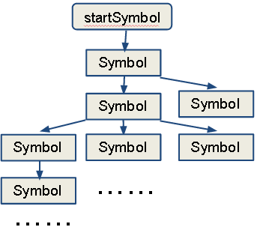
What is the deviation tree?
what it looks like:
what it really is:
The tree contains all Symbols created in the process
Nodes in the tree are Symbols
Get child_node by applying Gnode on parent_node

Slide 23
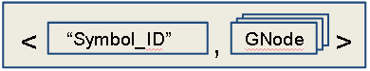
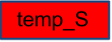
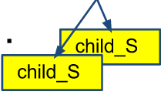
How is the tree created?
take a rule from the rule set
search “Sybmol_ID” through the tree, mark them
apply GNode(s) on marked Sybmols
append childSymbol with the function

Slide 24
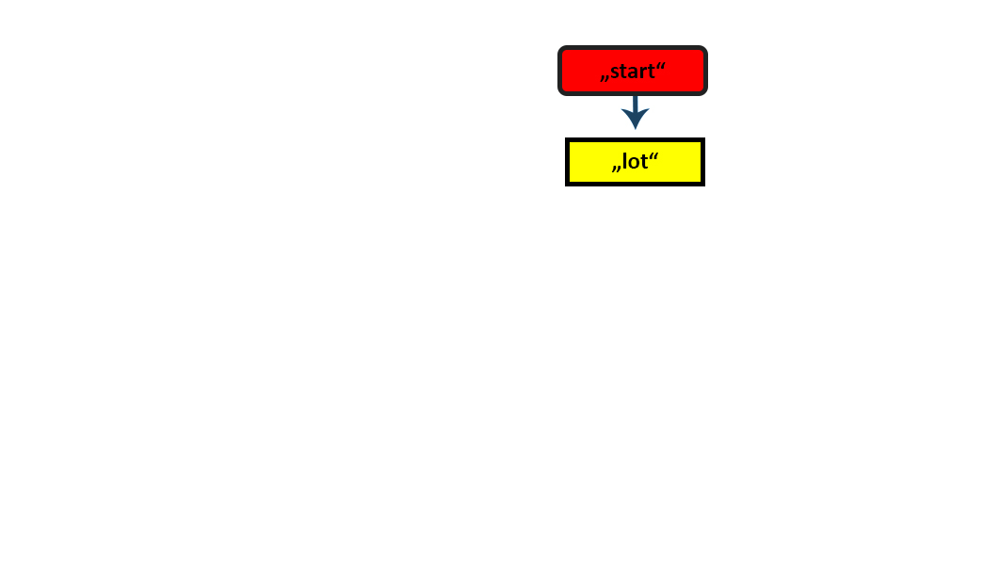
Let’s start it with a box:
position (0, 0, 0 )
scale (1, 1, 1 )
name “start”
start.sale( s1, s2, s3, “lot”)
position (0, 0, 0 )
scale (s1, s2, s3 )
name “lot”
lot

Slide 25
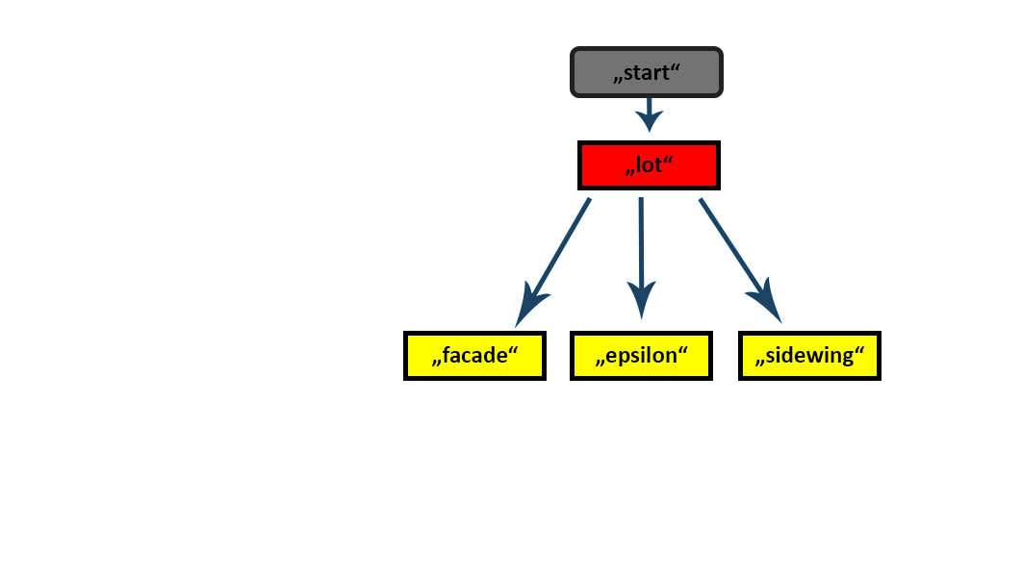
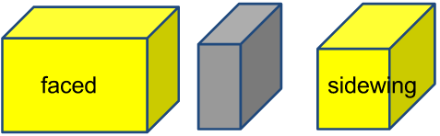
then
position (0, 0, 0 )
scale (s1, s2, s3 )
name “lot”
lot
lot
subDiv (“X”, d1, d2, d3 , “faceds”, “epsilon”, “sidewing”)
(0, 0, 0 )
(d1, s2, s3 )
“faced”
(d1, 0, 0 )
(d2, s2, s3 )
“epsilon”
( d1+d2, 0, 0 )
(d3, s2, s3 )
“sidewing”

Slide 26
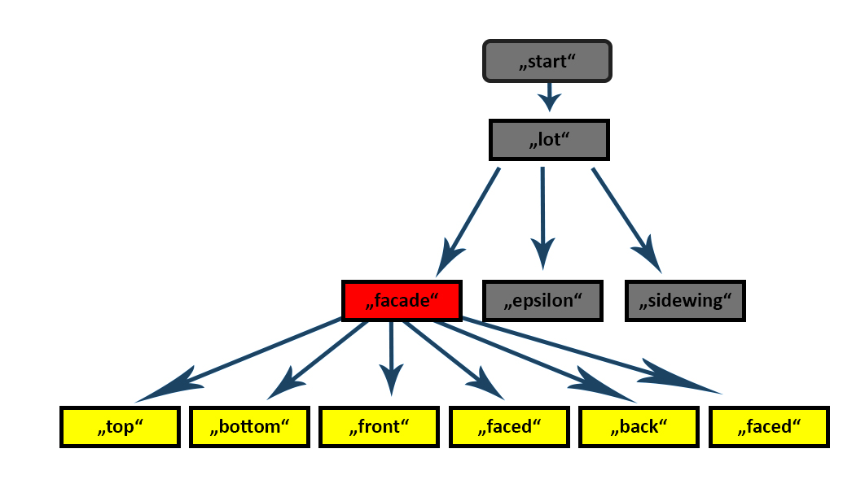
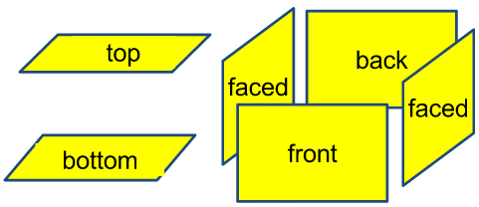
Now we can apped the tree
position (0, 0, 0 )
scale (d1, s2, s3 )
name “faced”
facade
comp (“top”, “bottom”, “front”, “faced”, “back”, “faced”)
Notes:
picture

Slide 27
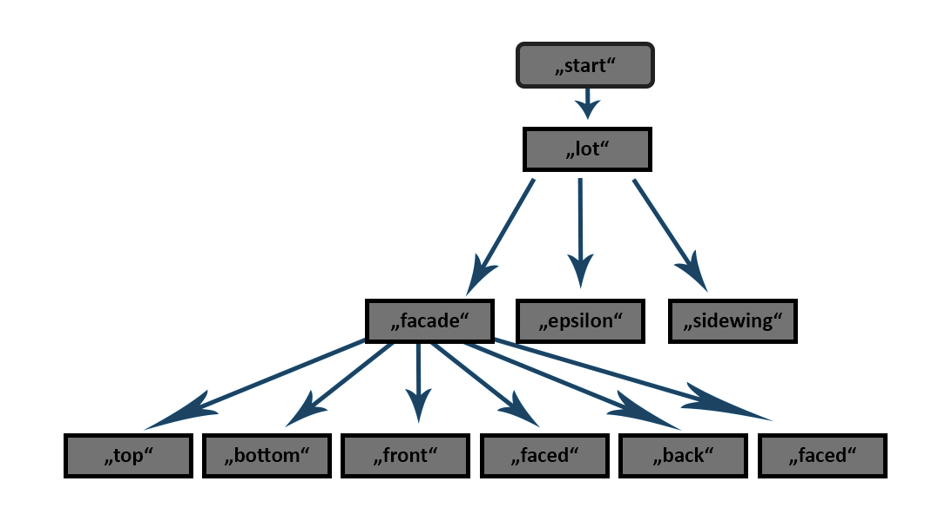
Functions & Naming
Scope rules:
Translation
Scaling
Production rules:
Subdivision
Component split
Renaming
Naming Convention:
When a Symbol is called “epsilon” it is set to inactive

Slide 28
Visualization :
Nicola Krombach

Slide 29
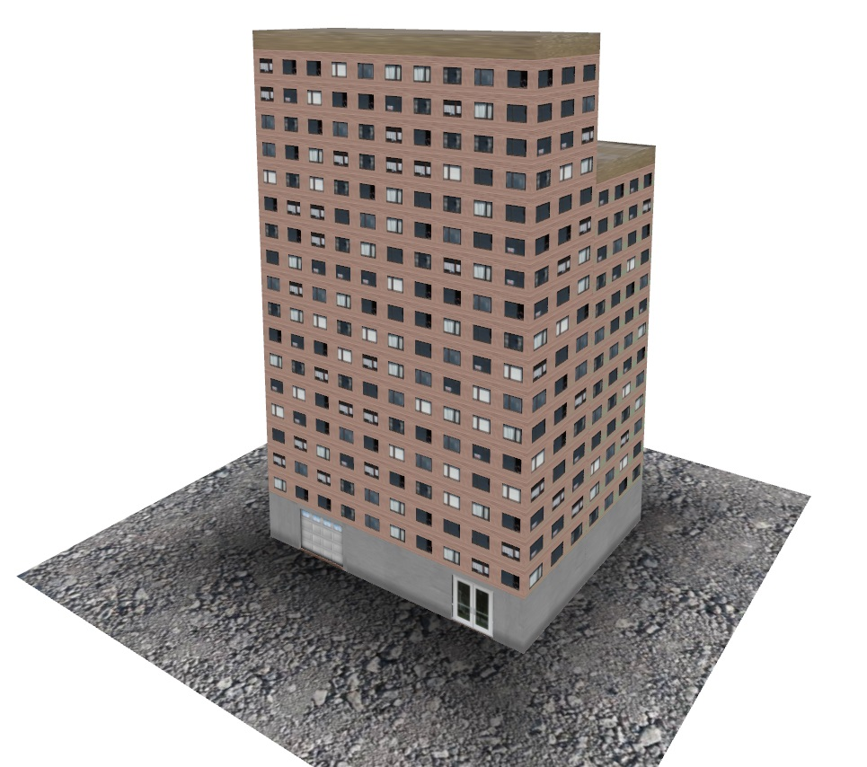
Task
draw derivation tree generated from modeling
interactive movement in scene
navigate tree history

Slide 30
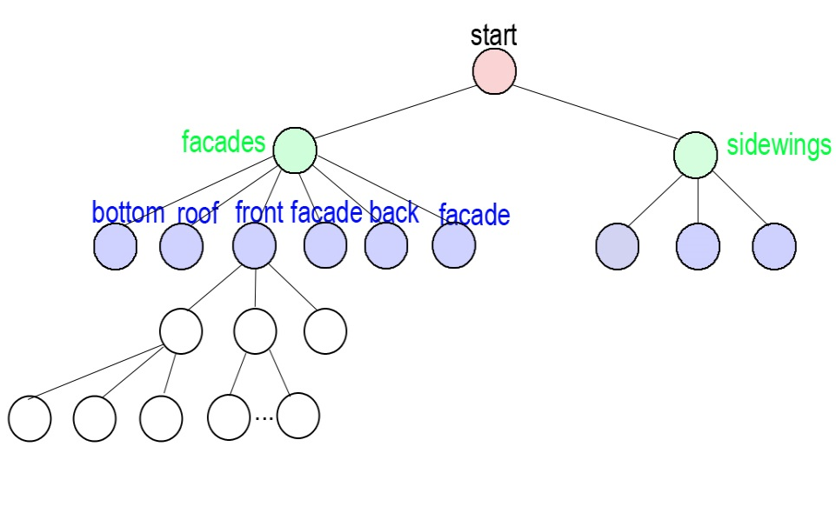
Derivation tree
Symbols as nodes -> attributes like position, scale, type
Traverse over leaf nodes and draw them in scene at a given position and scale
Apply different textures for symbol types -> e.g. for windows, doors, roof, wall
Possibility to switch between different texture sets

Slide 31
Office Building
# Lines in the Grammar: 92
# Nodes in the tree: 6496*
# Leaf Nodes: 4235
Depth of the tree: 18
*rand[a,b] function in grammar causes height and width variation

Slide 32
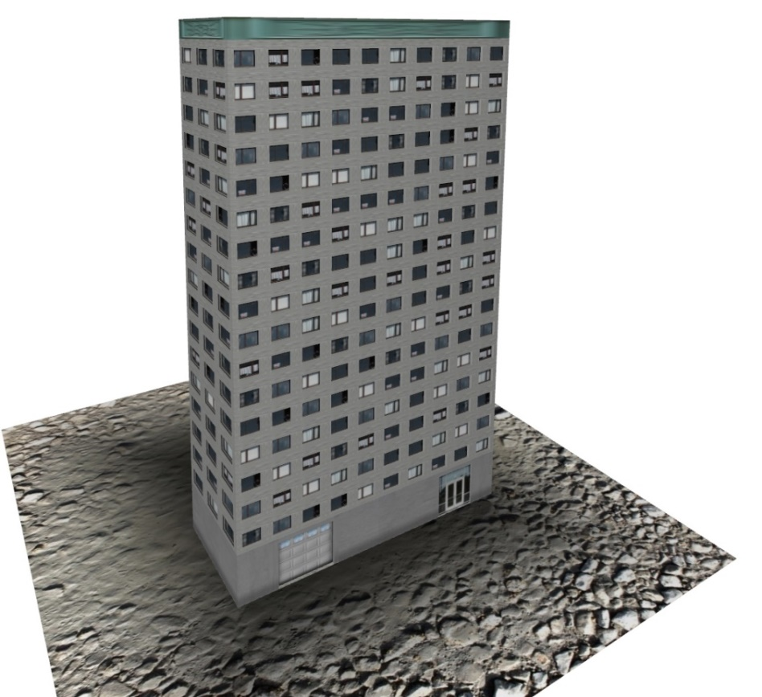
Office Building
# Lines in the Grammar: 92
# Nodes in the tree: 11777*
# Leaf Nodes: 7690
Depth of the tree: 18
*rand[a,b] function in grammar causes height and width variation

Slide 33
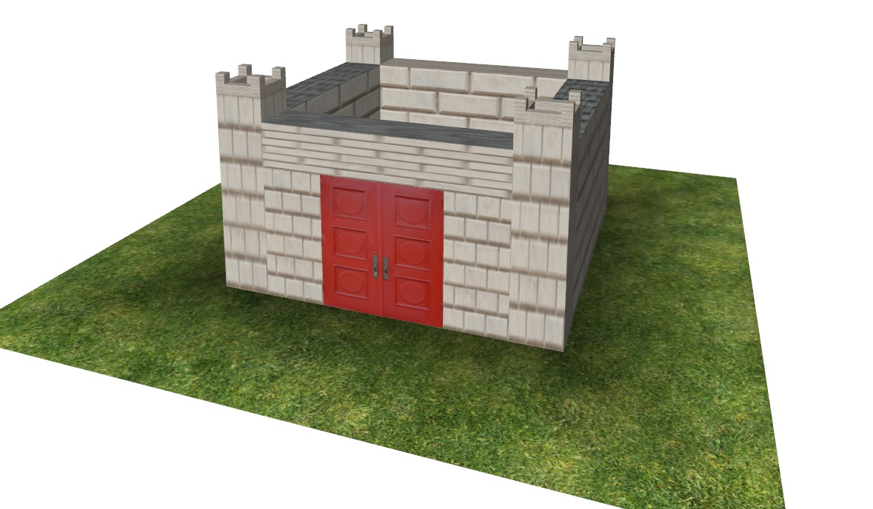
Castle
# Lines in the Grammar: 17
# Nodes in the tree: 111
# Leaf Nodes: 53
Depth of the tree: 9

Slide 34
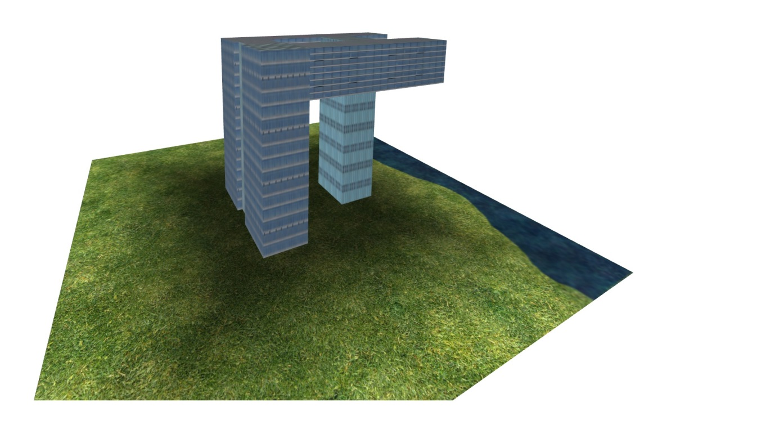
„Crane“
# Lines in the Grammar: 29
# Nodes in the tree: 58
# Leaf Nodes 38
Depth of the tree: 7

Slide 35
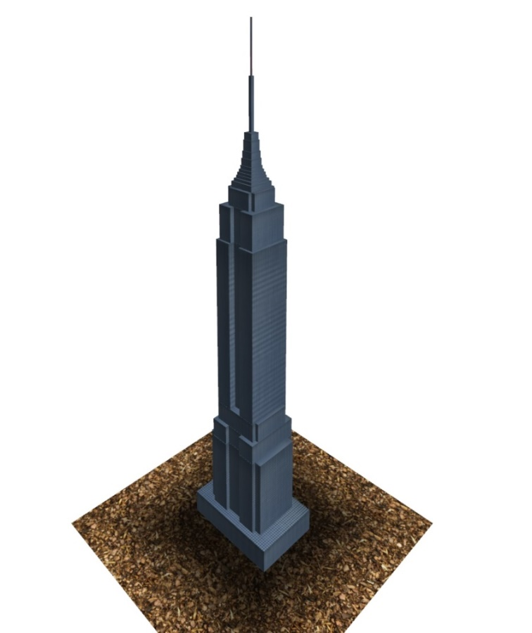
Empire State Building
# Lines in the Grammar: 120
# Nodes in the tree: 223
# Leaf Nodes 95
Depth of the tree: 21

Slide 36
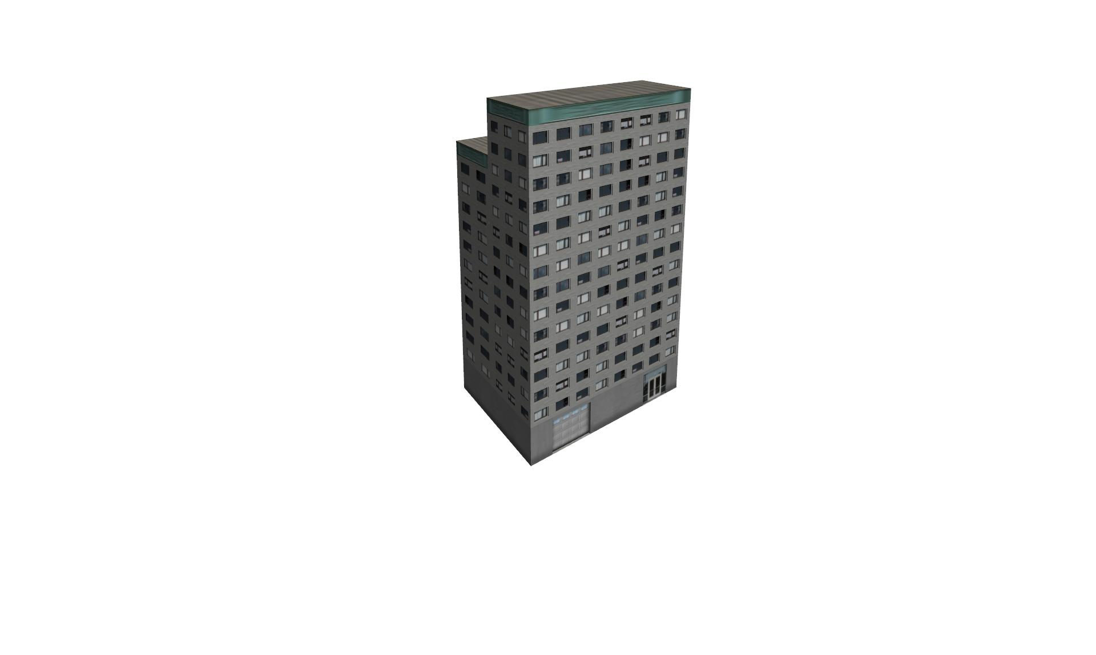
Movement in scene
Interactive 3D-movement in scene: zoom in/out move to left/right/up/down circle around building pan camera view

Slide 37
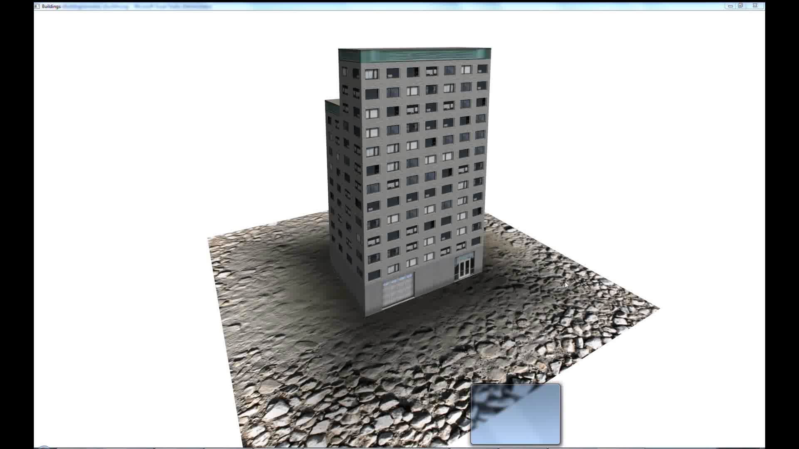

Slide 38
Navigate tree history
Visualisation of bottom-up model of the complete building
Go back and for in the creation of the tree from drawing a simple cube to complex building

Slide 39
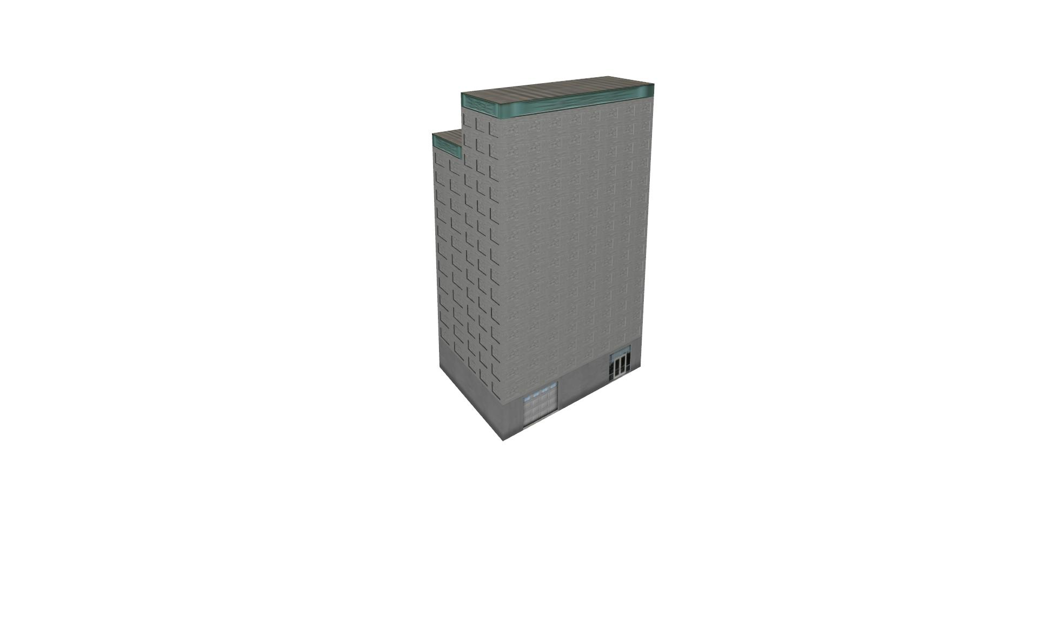
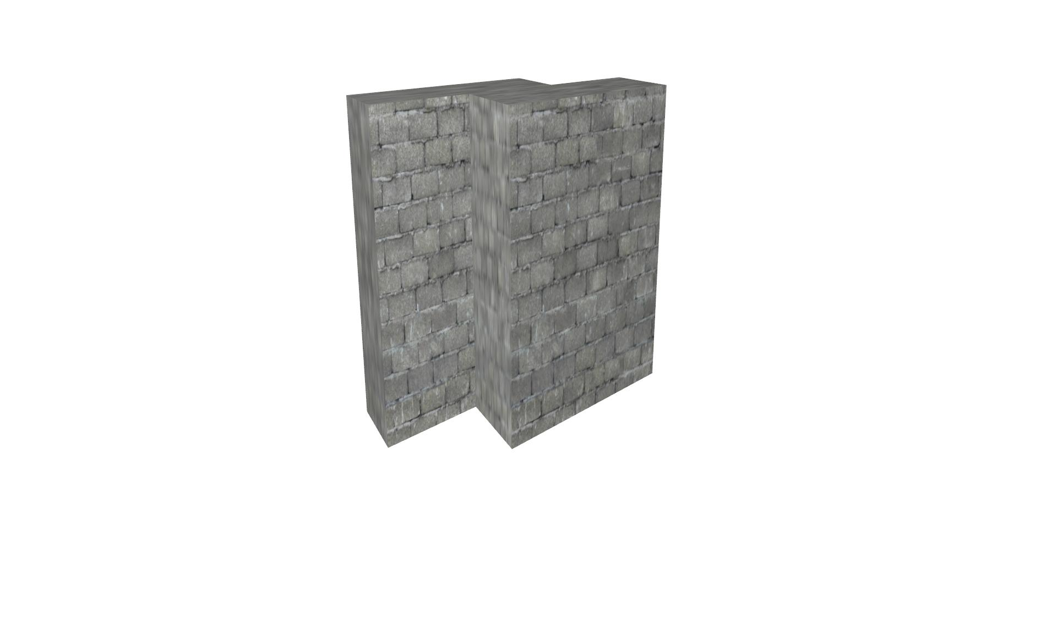
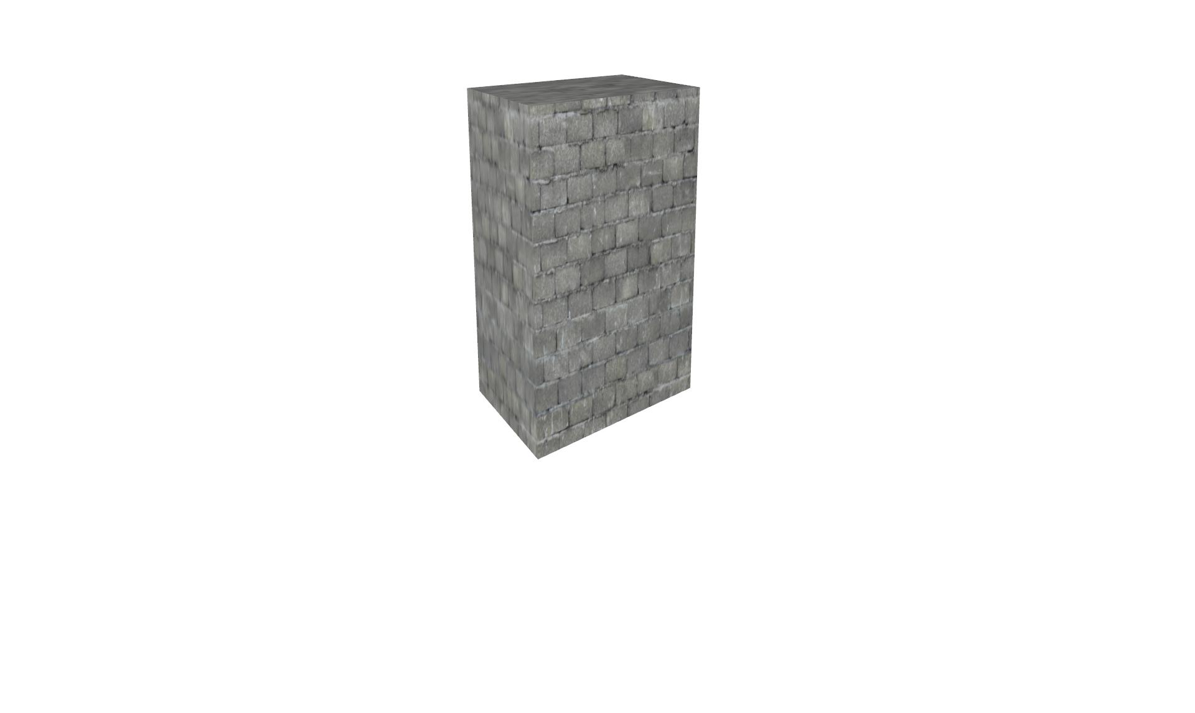
Navigate tree history

